Slide 1

E-COMMERCE PROJECT
OSMAN ARAT
COMPUTER ENGINEER

Slide 2
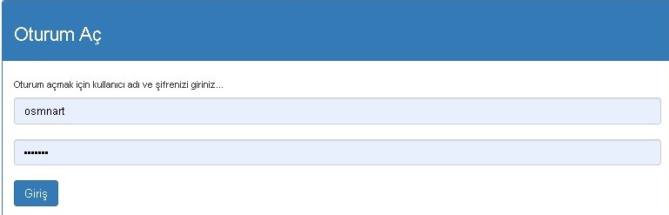
ADMIN PANEL
To enter the admin panel: you must write www.domain.com/iste_eticaret/admin in the address line.
Next, you must enter the admin username and password.

Slide 3
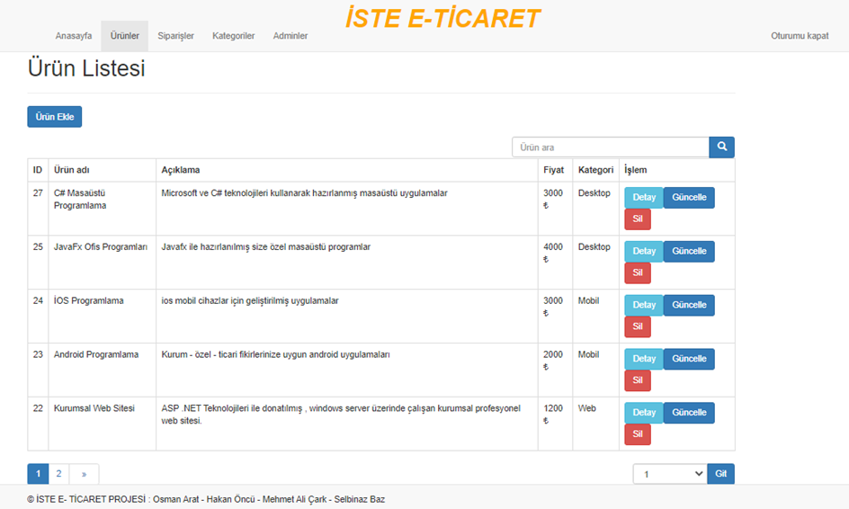
PRODUCTS

Slide 4
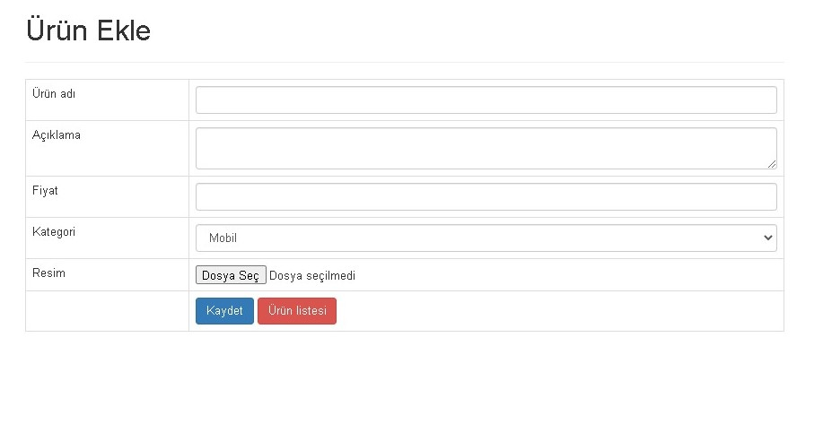
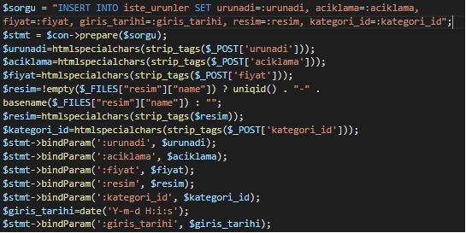
ADD PRODUCT
You can add pictures to your products.

Slide 5
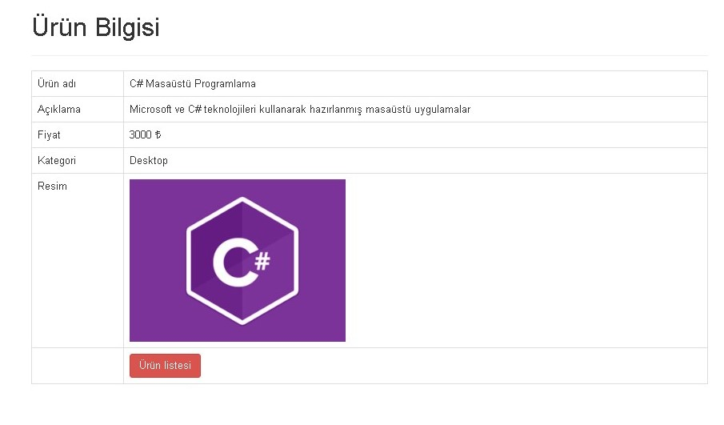
PRODUCT DETAİLS
You can see the product details on this page.

Slide 6
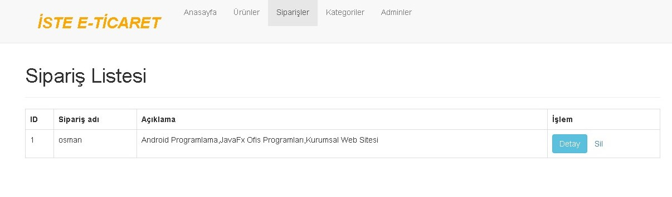
ORDERS
Orders are dynamically listed on this page

Slide 7
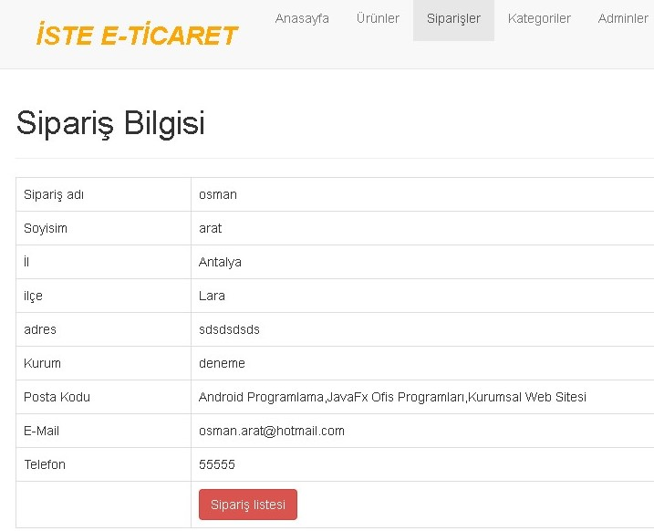
ORDER DETAİLS PAGE

Slide 8
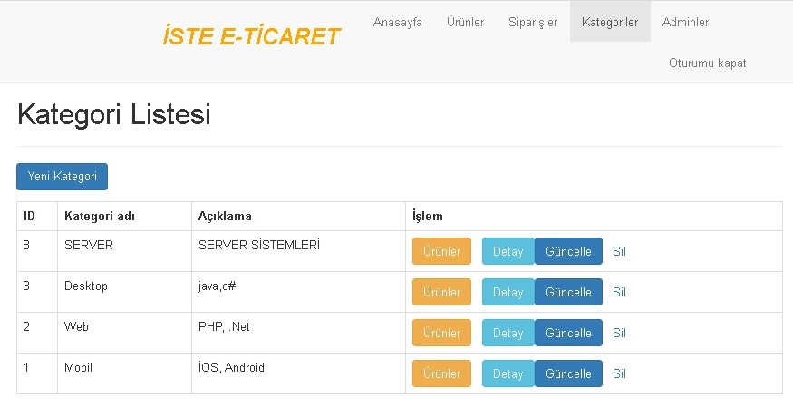
CATEGORY LIST
here you can dynamically add, delete and update categories.
In addition, you can view products in the specific category.

Slide 9
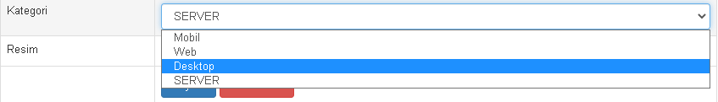
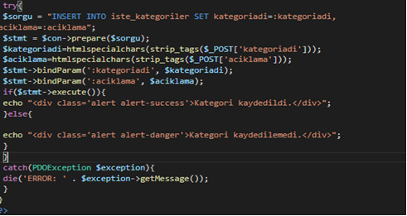
CATEGORİES PAGE
After coming to our categories page, click on the products page and you can see the products belonging to that category. You can update and delete categories. Category Category insert codes:

Slide 10
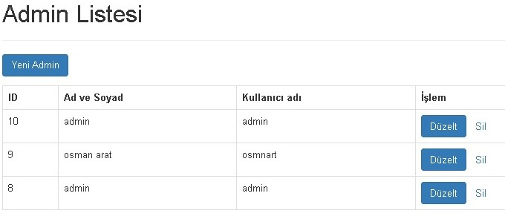
ADMİNS LİST
On the Admins page, there is information about the administrators who can log into the admin panel. A new admin can be added. Admin can be deleted. The registered admin can be updated. Admin add code :

Slide 11
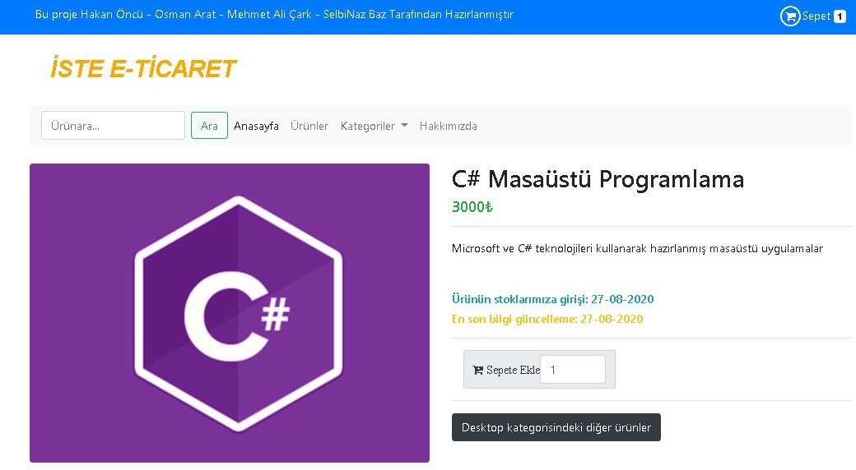
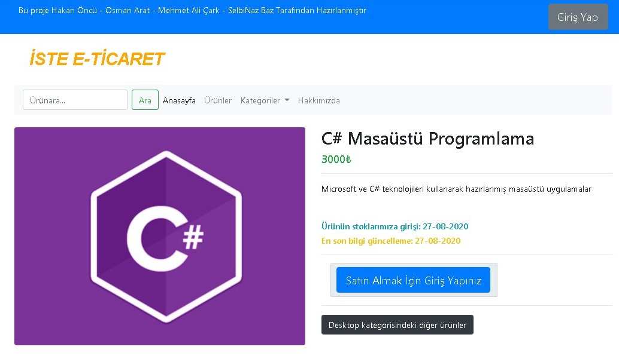
İN CASE OF NO LOGİN
Logged İn
Not Logged İn

Slide 12
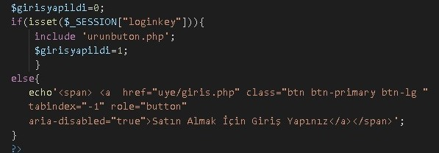
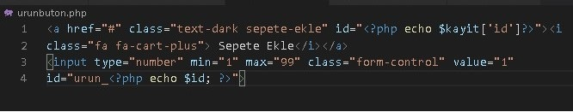
IS LOGIN DONE?
In addition to these, when the order is to be placed, if the customer has not logged in, he will be warned that must log in to purchase. The code written to create this is as follows:he

Slide 13
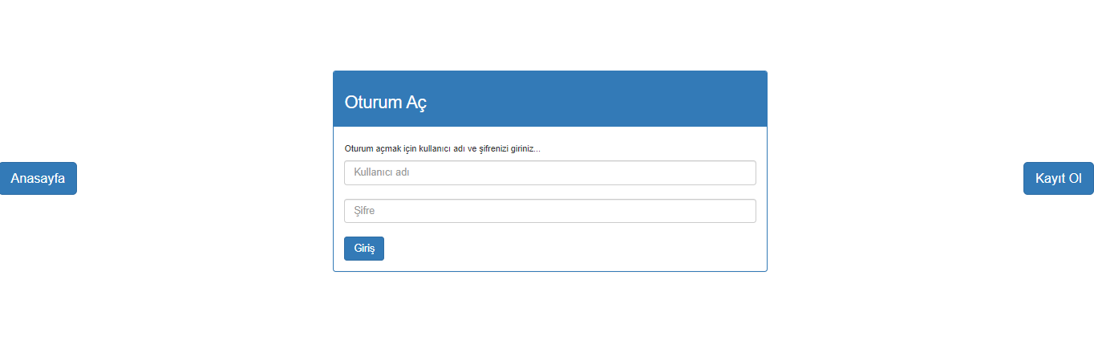
LOGIN PAGE
Here, member login transactions are done or if he is not a member, there is a redirect button for registration. Some of the codes used to create this are as follows:

Slide 14
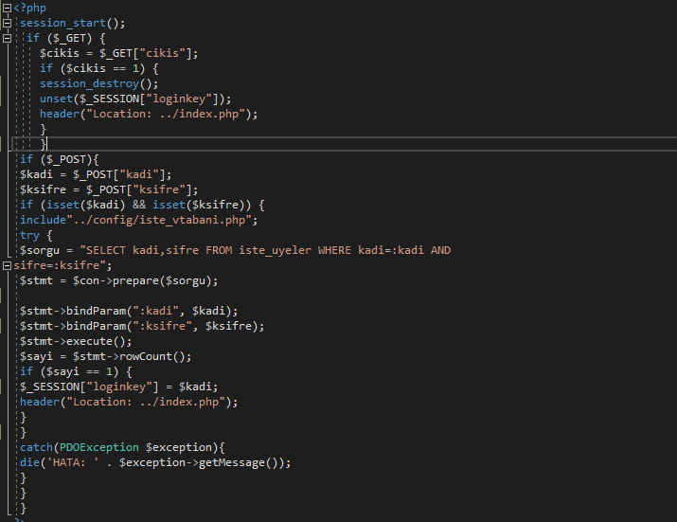
LOGIN

Slide 15
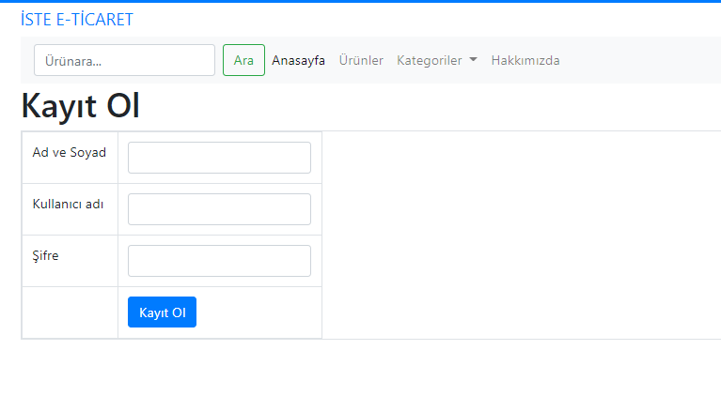
REGISTER PAGE
Here, the registration page is displayed. Some of the codes written to
create this page are as follows:

Slide 16
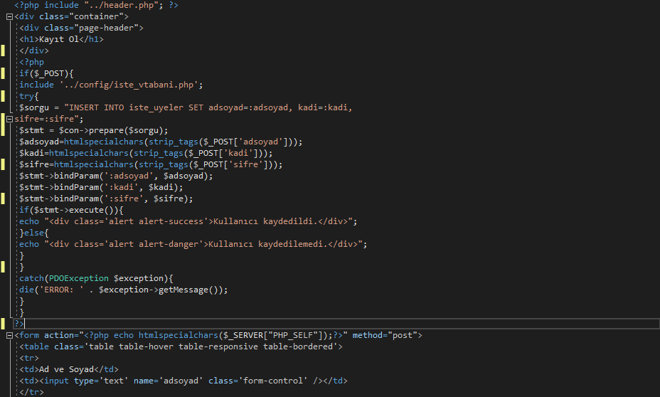
ADD MEMBERS CODE

Slide 17
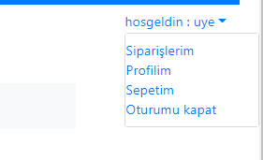
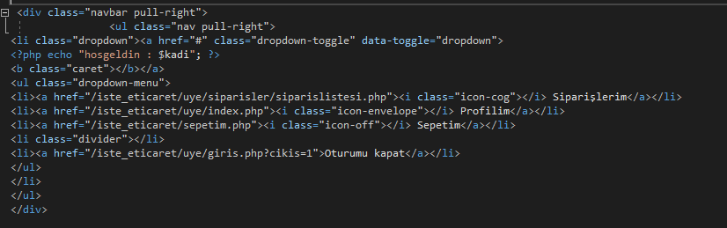
USER MENU PAGE
The user menu is located at the top right of the home page. Clicking on the menu shows options (my orders, my profile, my cart and log out). The code written for this part is as follows:

Slide 18
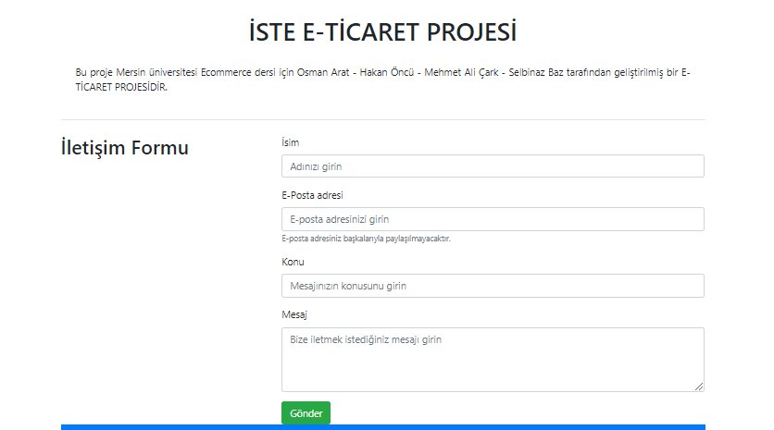
ABOUT US PAGE
When you enter the About section, there will be a promotional letter and a contact form of our site. The code written for this introduction and the creation of the contact form is as follows:

Slide 19
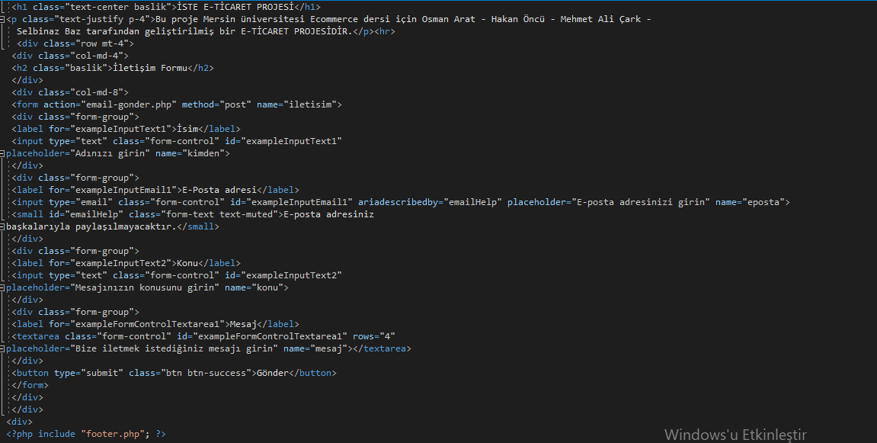
ABOUT US PAGE CODES

Slide 20
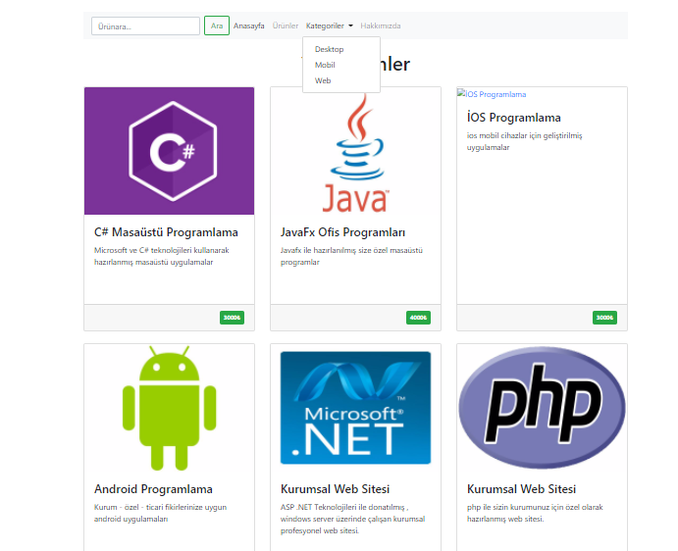
PRODUCTS PAGE
The products are displayed here. It is divided into categories, it is the page for viewing these categories and taking action. Some of the codes written to create this page are as follows:

Slide 21
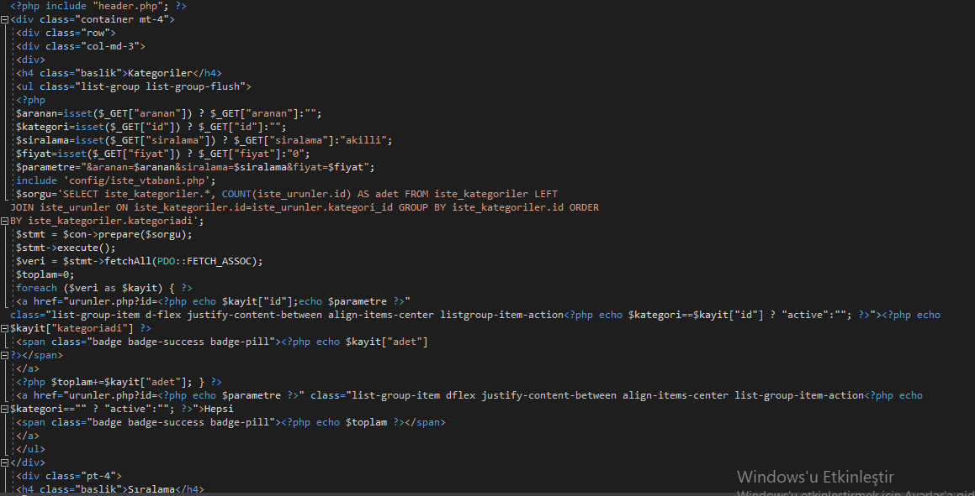

Slide 22
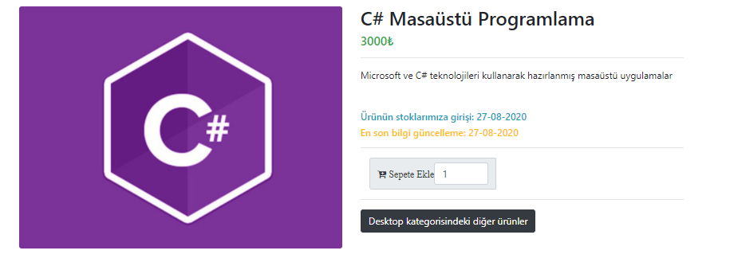
PRODUCT DETAIL PAGE
Details of the products are shown here. Information about the products is displayed. Some of the codes written for this page are as follows:

Slide 23
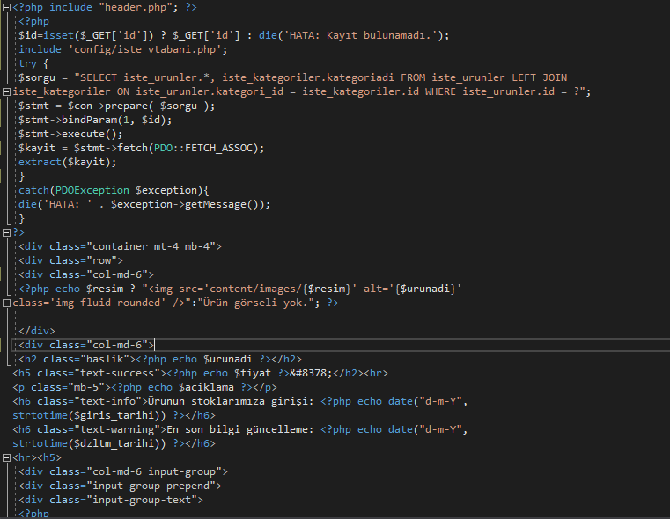
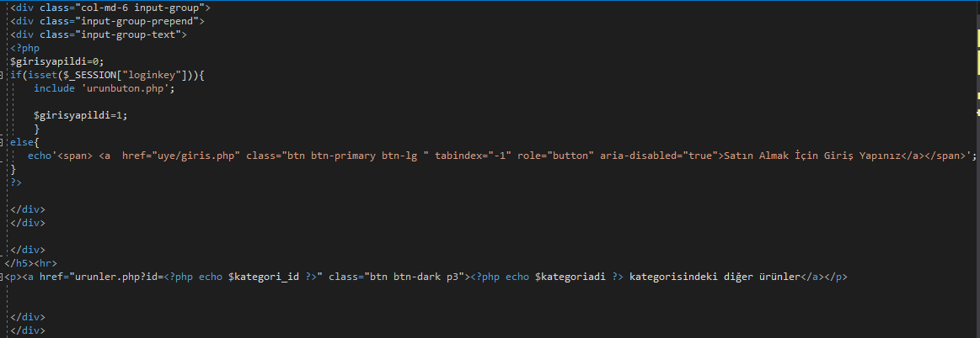

Slide 24

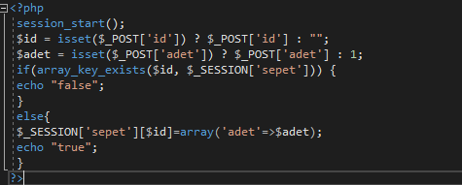
ADD TO CART
Adding to the cart is done here. When the Add to Cart button is clicked, the product is added to the cart. Here, the selection of the product is made. The products that are in the cart are not added to the cart again. The code written for this is as follows:

Slide 25

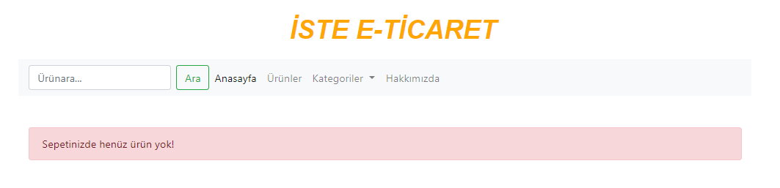

CART
After logging in, members can view their cart from the top right of my page.
1- No products in the cart
When no product is added to the cart, a warning will appear that there is no product in the cart yet. The code written for this warning is as follows:

Slide 26
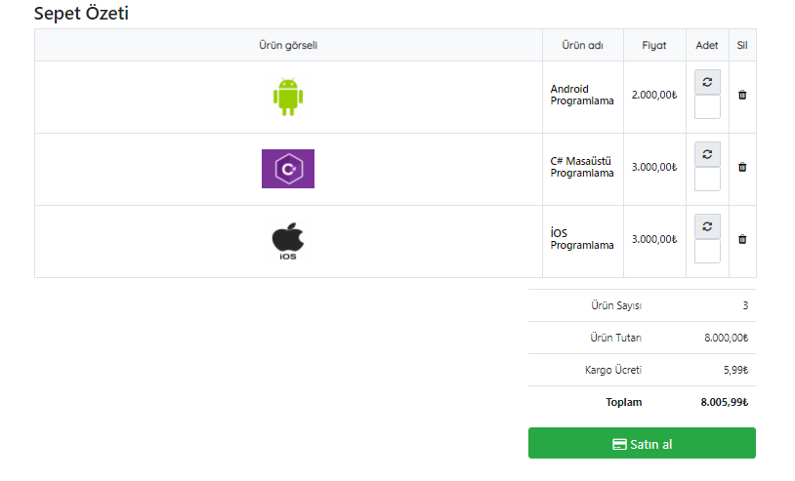
CART /Listing products in the cart
If the cart is not empty, the products added to the cart are listed after clicking the cart. Here you can view the products in the cart and make changes (such as add, remove and update operations). Some of the codes written to list the products in the cart are as follows:

Slide 27
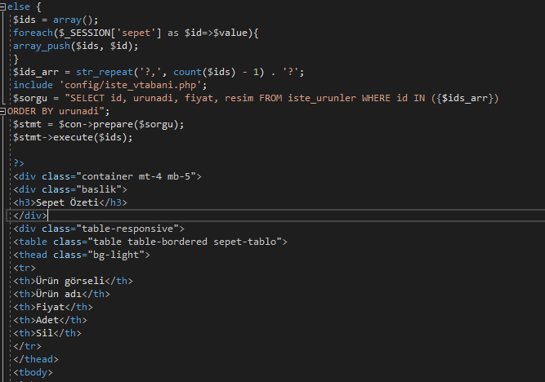
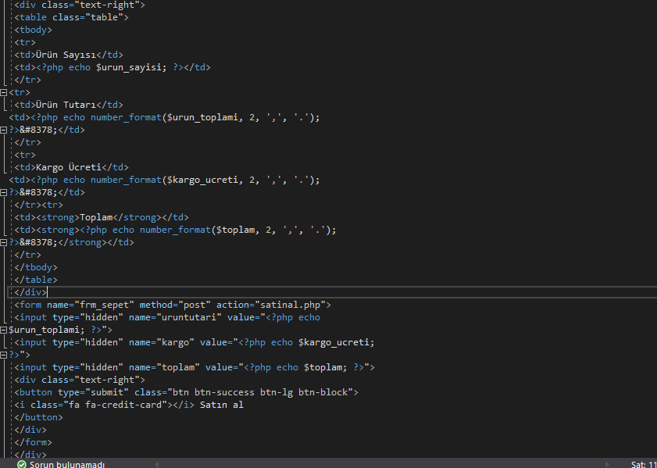

Slide 28
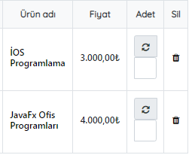
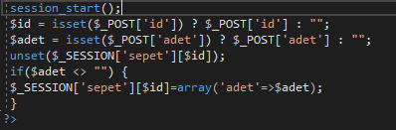
UPDATE CART
Updates such as deleting products from the basket can be done here. The code written for this is as follows:

Slide 29
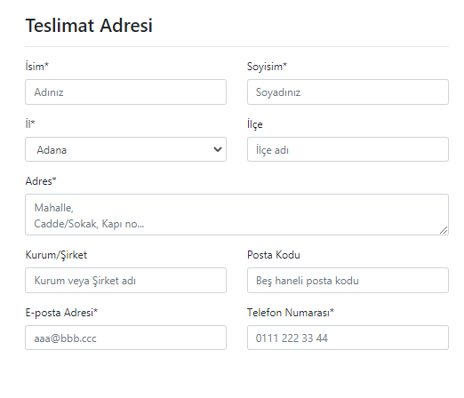
BUY PAGE
Delivery address
The address form required for the product to reach the buyer. Some of the codes written to create a delivery address form are as follows :

Slide 30
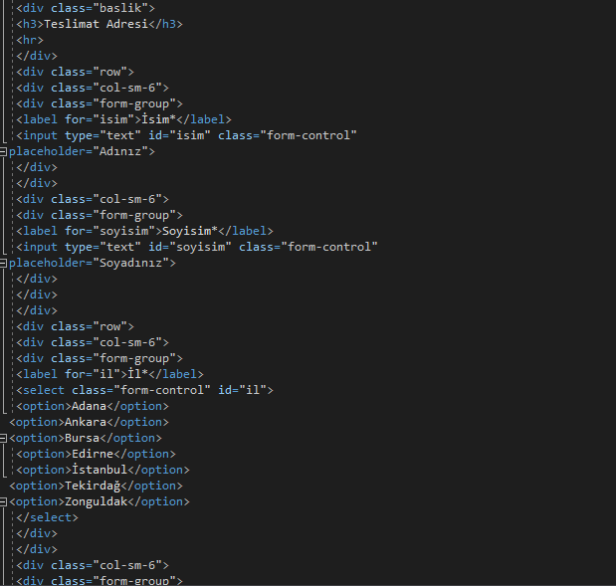

Slide 31
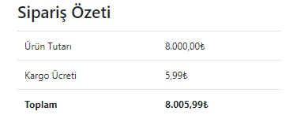
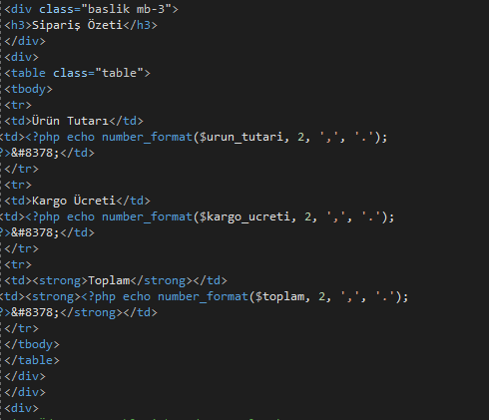
BUY PAGE/Order Summary
Here is the information about the products to be purchased. The code written to create the Order Summary is as follows:

Slide 32
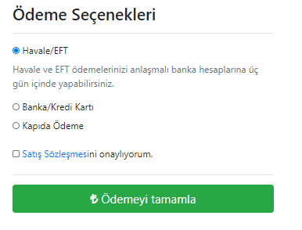
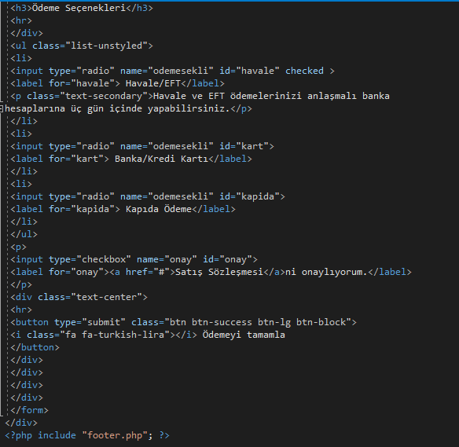
BUY PAGE/3-Order Payment Options
There are payment options here. The code written to create payment methods is as follows:

Slide 33
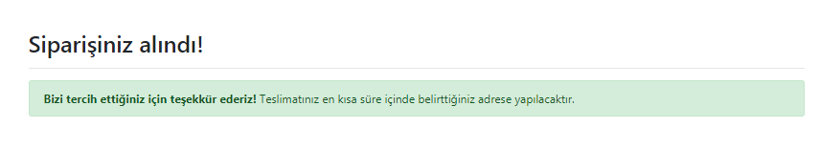
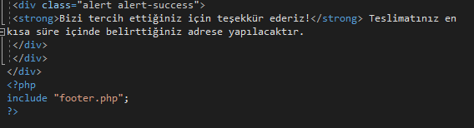
ORDER CONFIRM PAGE
Here, an information message about the confirmation of the order is displayed. The code for this is as follows:

